Slide 1
Beyond the Hype
Real-World Lessons from Building AI into Enterprise Data Management

Slide 2
AI
Notes:
Lessons learned — relevant to any data leader — from deploying AI across the product and engineering lifecycle.

Slide 3
How we balance AI adoption and Risk
Internal AI Usage
Writing Emails
Recording/Transcribing Meetings
Generating Code
Gathering Product Feedback
Writing Features/Stories
Writing Marketing Materials
Employee driven, lower risk
Customer Facing AI
Chat agents for learning/support
Creating customer data
Updating customer data
Communicating to customer
Updating customer facing systems
Do things for the customer
Customer driven, higher risk
Notes:
We think about internal usage of AI very differently from AI features built into our product, with very different controls.
Tell story of meeting with Pamlico CTO community.
Tell story of research where most AI “harm” (reputation/financial damage) has come from customer chat bots going off the rails.

Slide 4
Controlled freedom
Internal AI adoption shouldn’t be top down
The biggest AI risk to Enterprises is stifling its usage
We allow anyone to experiment with any AI tool, unless black-listed (ex. DeepSeek)
Our primary policy constraint is limiting the data that can be used
  Customer data managed in Profisee
  Profisee financial data
  Profisee source code
  Etc.
Employees will be best at finding creative ways become better at their jobs
Notes:
Share story of security team setting up meeting to define AI policy, and how we ultimately approached it. Caveat that appetite may be very different based on region, vertical, etc.

Slide 5
Use of AI in Profisee R&D
AI in Product Management enables the full benefit of AI in Engineering
Product MGMT
Engineering
QA
TASKS
Identify customer needs
Write features/stories
Detailed requirements and acceptance criteria
Craft detailed instructions
Generate code at scale
Test automation
Write test cases
Validate automated tests
TOOLS
Build Better
Bolt.new
Claude
Cursor
GitHub Copilot
Claude
M365 Copilot
Claude
M365 Copilot
Notes:
Talk through how we’ve progressed from using AI in engineering, to realizing we needed to use it in product. Our goal is to use savings to automate more, reducing the effort for QA.

Slide 6
Why we aren’t Measuring AI ROI Yet
Breakeven Point for AI Tools*
We are 100% Focused on driving AI Adoption and building our AI Muscle
Tool | Monthly Cost** | Minutes to ROI
Cursor | $40/month | 40 min./month
Claude | $30/month | 30 min./month
ChatGPT | $30/month | 30 min./month
GitHub Copilot | $39/month | 39 min./month
M365 Copilot | $30/month | 30 min./month
*Assuming $100K salary with 20% benefits
** Approximate costs, will vary with enterprise agreements
Notes:
Tell story of CEO asking why can’t we use AI to do Admin in the Web
I’ve argued against trying to measure AI ROI in the near term. As we drive adoption, it will make it’s way into the metrics we already measure.

Slide 7
Where will the majority of AI value be realized?
 | Internet Era | AI Era
Applications | E-commerce SaaS Social Media | AI Co-pilots Domain-Specific Assistants Autonomous agents
Tools | HTML JavaScript Flash | LangChain Hugging Face OpenAI API
Platform | Browsers HTTP Web Servers | Foundation models Orchestration layers Vector DBs
Hardware | Routers Servers Fiber | GPUs Data centers Power
Value
Differentiation
Commodities
Race to the bottom
AI value creation will come from companies that:
Own the user relationship and integrate AI seamlessly.
Create proprietary data flywheels — not just use shared foundation models.
Deliver real productivity, creativity, or decision-making gains.
Notes:
Draw parallels to internet .com boom/bust. Initial build out of infrastructure, lower-level tooling. This could easily be a bubble.
Long-term, the lower level items will become increasingly a commodity, available to all.
The majority of long-term value will be realized at the application layer.
This isn’t just for pure tech/AI companies. All enterprises can capture value from AI.

Slide 8
Agentic AI differentiation
Components | Purpose | Example Technologies
AI Interface | Where users use agents | Teams, Slack, Copilot, Claude
Orchestrator | Multi-step planning | Langchain, Semantic Kernel
Enterprise connectivity | APIs, Connectors | SAP, Dynamics, Salesforce
Data Platforms | Consolidated data semantics and access | Databricks, Fabric, Snowflake
Unified data | Authoritative data source | Profisee
Models | Core AI capabilities | GPT-5, Claude 3, Gemini
Your Data can be a key to providing differentiated value
Notes:
AI tooling today is still very technical.
At Profisee, we have not built any internal Agentic applications, but are just using the agent capabilities of COTS.
We’ve built Agentic capabilities into our platform, but there are very technical development tools today
Today, it isn’t possible for end users to built agentic solutions. You have to either buy them (i.e. Cursor), or build them.

Slide 9
Your Data foundation can become your AI differentiator
Today → AI writes, summarizes, and chats | Built on text | Individual productivity
Tomorrow → AI reasons, plans, and decides | Structured + unstructured | Enterprise intelligence
Current State
Structured Data
What’s Next
90%+ of enterprise AI pilots focus on unstructured text
Most enterprises still rely on BI, not LLMs, for structured insight
Enterprises with clean, governed data will unlock AI value
Chat assistants for productivity
Knowledge retrieval & summarization
Code generation
AI yet reason over a data warehouse
Immature tooling
Fragmented data: multiple lakes, inconsistencies
Semantic data layers
  Unity Catalog
  Snowflake Polaris
  Fabric OneLake
Master Data Mgmt: Consistent business entities and context

Slide 10





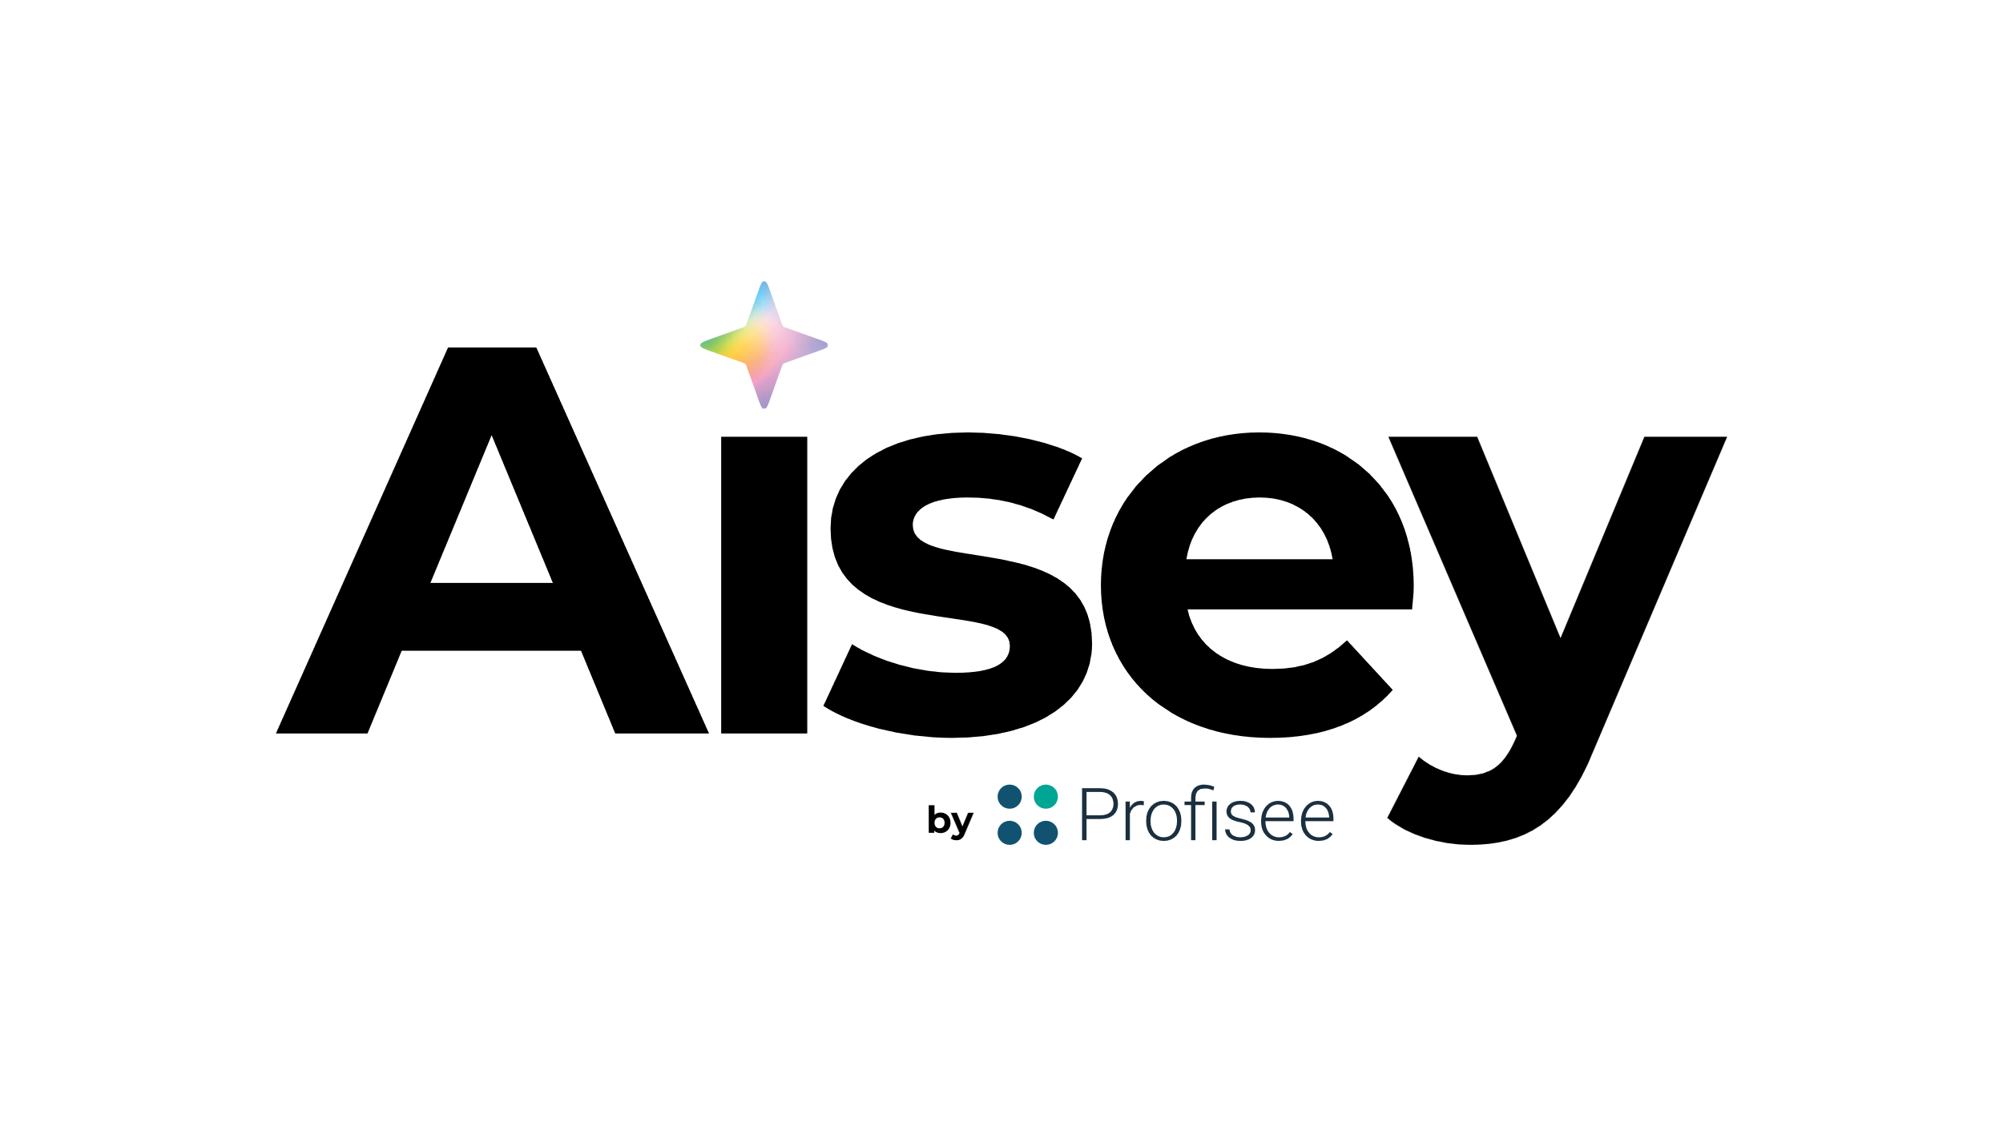
Profisee’s Vision for AI
AI
Profisee MDM Makes AI Better
…
Automation
Better Data
AI Makes Profisee MDM Easy

Slide 11
Q&A

